Slide 1
MOTILAL NEHRU NATIONAL INSTITUTE OF TECHNOLOGY ALLAHABAD
AI Driver Drowsiness Monitoring System
Real-time detection of sleepy driving with automated emergency photo alerts using OpenCV and MediaPipe
Submitted By — Team 10
Mukund Bihari Gupta (20233191)
Sachin Patel (20233237)
Sahil Singh (20233240)
Sahil Raja (20233555)

Slide 2



MOTIVATION
Why This Project?
Seconds Matter
Silent Fatigue
Zero Wearables
Brief dozing pushes vehicles off-lane instantly.
Gradual sleepiness goes unnoticed by drivers.
Standard webcam tracks eyes without body sensors.

Slide 3
CORE GOALS
System Objectives
01 Eye Closure Detection: Trigger alarm after 5 seconds shut.
04 Emergency Photo Email: Send live driver snapshot via Gmail.
02 Yawn Recognition: Flag wide mouth openings lasting 1.5 seconds.
05 Gesture Dismissal & Log: Stop alarm via thumbs-up; save CSV.
03 Continuous Audio Alert: Loop loud alarm until driver responds.

Slide 4




TECH STACK
Tools & Libraries Used
Python & Threading
OpenCV & NumPy
Core logic with non-blocking background emails.
Webcam capture, ratio math, 3D head pose.
MediaPipe AI
Pygame, SMTP & CSV
468-point face mesh and 2-hand tracking.
MP3 alarm, Gmail SSL alerts, event logs.

Slide 5


ARCHITECTURE
How the System Works
1. Webcam
2. MediaPipe
3. Measure
4. Timers
5. Action
Read mirrored frame
Map face & hand dots
Compute EAR, MAR, Pose
Check duration limits
Alarm, Email & CSV log

Slide 6
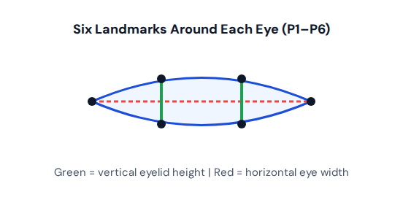


METRIC 01
Eye Closure Detection (EAR)
Closing eyelids shrinks vertical height and drops average EAR.
0.23
5.0 sec
EAR threshold
Closed before alarm

Slide 7
METRICS 02
Yawning Detection
Yawn Detection (MAR)
Formula: Vertical lip gap divided by mouth width.
Landmarks: Inner lips (13, 14) and corners (78, 308).
Trigger: MAR above 0.60 for 1.5 seconds.
Cooldown: 5-second pause prevents duplicate logging.

Slide 8




ALERT & EMERGENCY RESPONSE
Alarm, Photo Email & Gesture Reset
1. Audio Alarm
2. Photo Snapshot
3. Threaded Email
4. Thumbs-Up Reset
Loops beep.mp3 at 70% volume.
Captures live JPG frame immediately.
Sends Gmail alert then deletes photo.
5 consecutive frames stops alarm.

Slide 9
LOGGING & RESULTS
CSV Event Logging
Driver Situation | Dashboard Status | Automated System Action | CSV Event Logged
Normal attentive driving | MONITORING | Track eye polylines & ratios | SESSION_START
Eyes shut ≥ 5.0 sec | PROLONGED EYE CLOSURE | Play alarm + send photo email | ALERT_TRIGGERED
Mouth open ≥ 1.5 sec | PROLONGED YAWNING | Increment yawns + alarm & email | YAWN_DETECTED
Alarm active (0s delay) | ALERT ACTIVE | Background Gmail photo dispatch | EMERGENCY_NOTIFICATION_TRIGGERED
Thumbs-up held 5 frames | MONITORING | Stop alarm & reset all timers | ALERT_DISMISSED
Face missing ≥ 10 frames | NO FACE DETECTED | Reset eye and yawn timers | SESSION_END (on quit)
Dashboard : Displays live Session Timer, EAR, MAR on top-left and Alerts, Yawns, Dismissals on top-right.

Slide 10
CONCLUSION & Q&A
Conclusion & Future Work
What We Built
Future Improvements
Contactless Monitor: Real-time tracking via standard webcam.
Custom Calibration: Set baseline EAR per individual driver.
Multi-Sign Detection: Catches prolonged eye closure and yawning.
Night Vision: Add infrared (IR) camera support for dark roads.
Emergency Dispatch: Threaded Gmail alerts with live driver photo.
Nodding Alerts: Trigger alarms from pitch/yaw head drops.
Hands-Free Control: Thumbs-up dismissal and full CSV logging.
Edge Deployment: Run standalone on Raspberry Pi in vehicles.
Thank you! Any questions?

